Slide 1







ShopRite
(E-Commerce)
Cross-Platform Shopping App in Flutter

Slide 2


Definition Of Done (DODs)
A
Create a cross-platform shopping app in Flutter, enabling users to browse products, add them to carts, and checkout securely (integration with payment gateways required).
B
Utilize product filtering and search functionality alongside product reviews to enhance user experience.
C
Integrate with inventory management APIs (if available) and state management for real-time product availability and user cart updates.

Slide 3

Overview
Develop a cross-platform shopping app using Flutter.
The ShopRite E-Commerce application is designed to provide a seamless shopping experience across multiple platforms using the Flutter framework. The main objective is to develop a robust app that allows users to browse products and manage their carts. The app consists of several key modules, including product browsing, cart management, and user profile management, all aimed at enhancing user experience and functionality.

Slide 4



Features

Slide 5
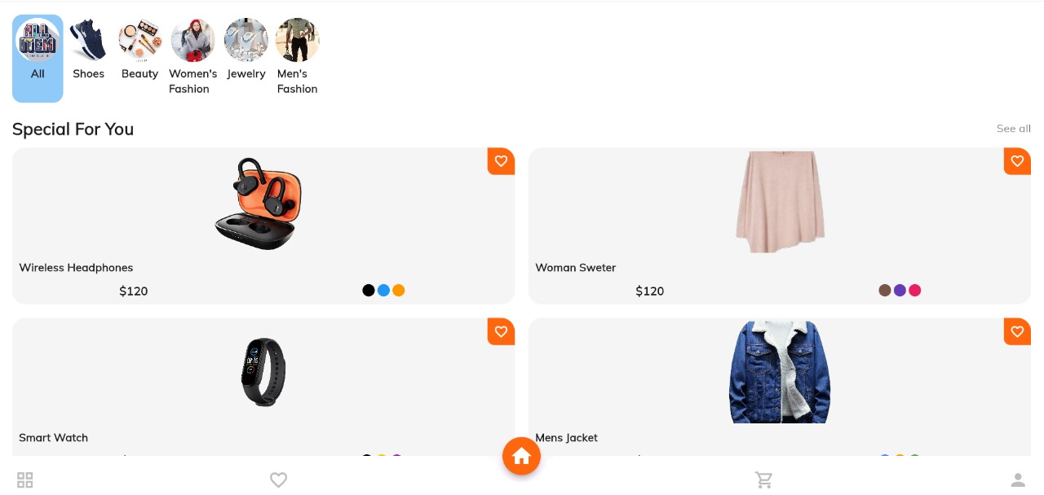
Product Browsing and Details
Explore various product categories like All, Shoes, Beauty, Women's Fashion, Jewelry, and Men's Fashion. Each product page provides detailed information including photos, names, ratings, available colors, seller names, and an option to add items to the cart with a specified quantity.

Slide 6

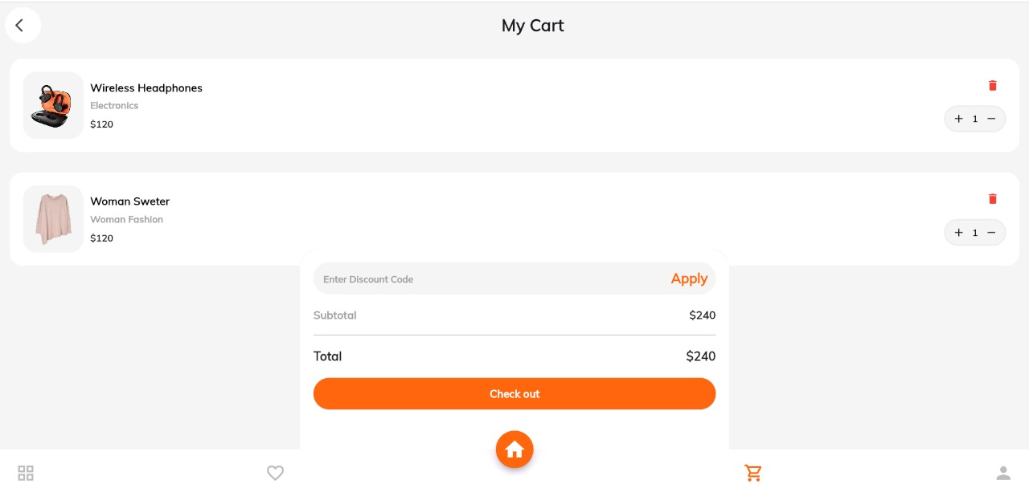
Cart
Search and Favorites
The cart page displays subtotal and total amounts, with a checkout button. Users can manage their personal information in the user section, ensuring a streamlined and secure shopping process.
The app includes a search bar for quick product discovery and a favorites section to save items for later, enhancing the user experience by making it easy to find and revisit products.

Slide 7

Technology Stack

Slide 8


Frontend
Backend
Flutter for cross-platform compatibility
Firebase for real-time database and authentication
Flutter enables rapid development of visually appealing and performant applications across various platforms like iOS, Android, and web from a single codebase.
Firebase, a Google platform, provides real-time database and authentication services, handling user authentication and managing real-time data for the application.

Slide 9


State Management
APIs
RESTful APIs for inventory management
Provider/Bloc
RESTful APIs serve as a standard means for the application to communicate with servers, allowing for the manipulation of product data such as fetching, updating, and managing inventory.
Provider and Bloc are efficient state management solutions in Flutter, aiding in managing application state and separating business logic from UI components for better code organization.

Slide 10


Workflow

Slide 11
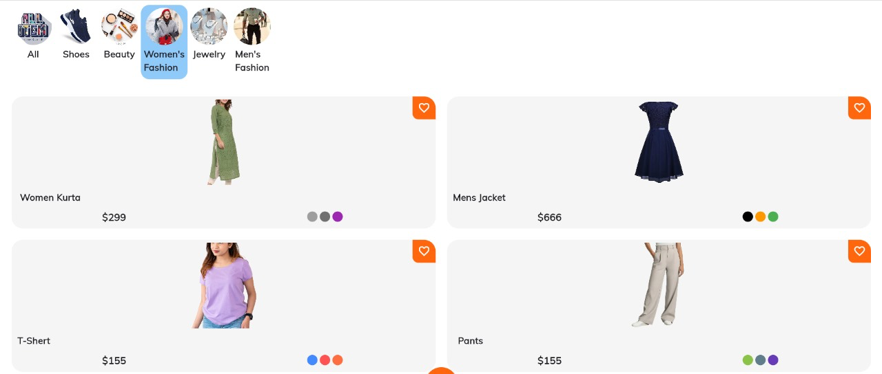
Workflow
Home Page
Browse Categories

Slide 12
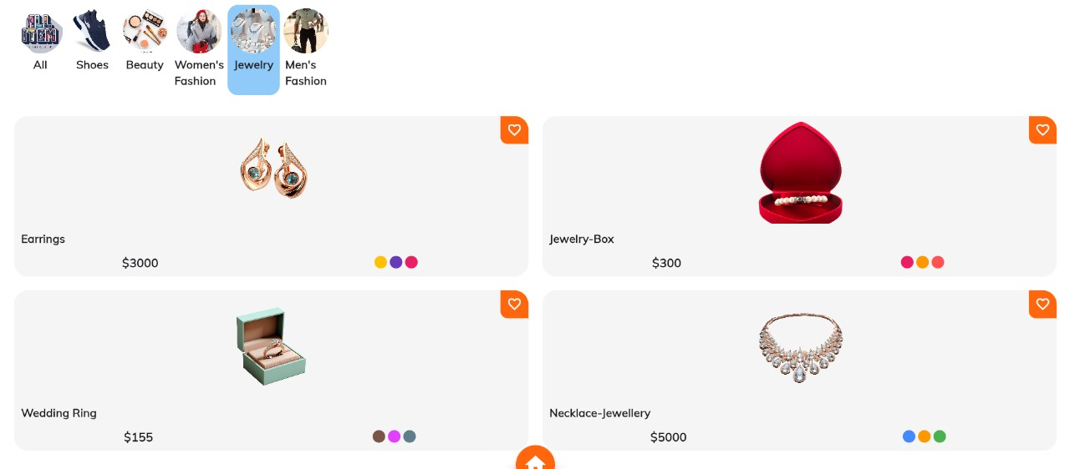
Workflow
Home Page
Browse Categories

Slide 13
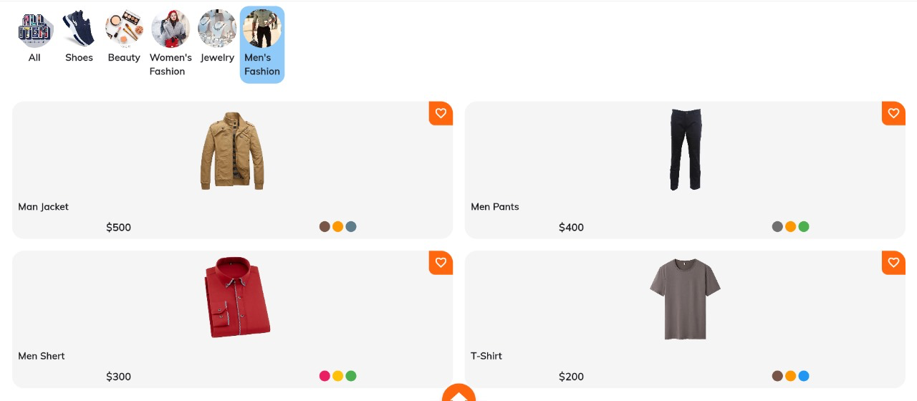
Workflow
Home Page
Browse Categories

Slide 14
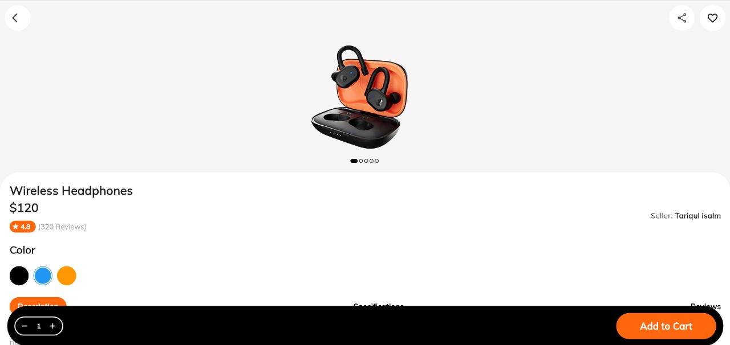
Workflow
Product Page
View product details and add to cart

Slide 15
Workflow
Search
Find products using the search bar

Slide 16
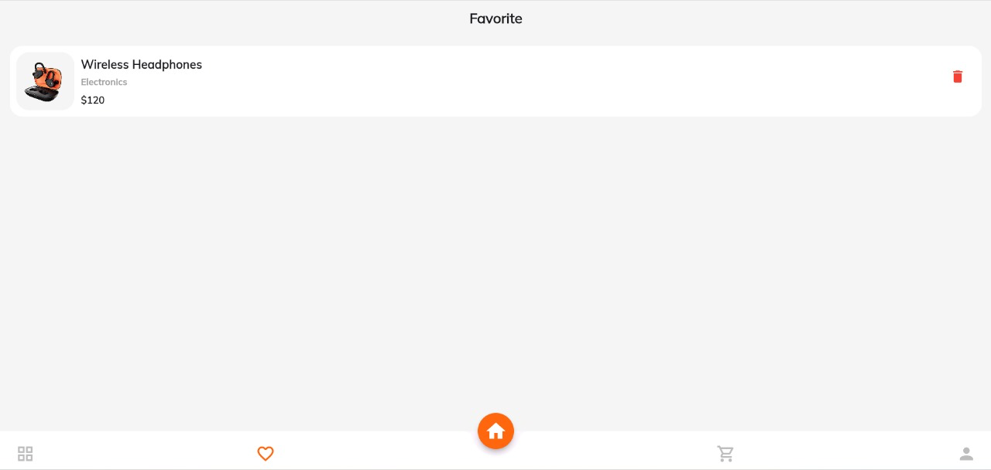
Workflow
Favorites
Save products for later

Slide 17
Workflow
Cart
View cart, adjust quantities, see totals, and proceed to checkout

Slide 18

Workflow
User Section
Profile and preferences

Slide 19

Future Enhancements
Payment Options:
Integrate additional payment gateways (e.g., Apple Pay, Google Pay)
Backend Integration:
Link with comprehensive inventory management systems
Improve user data analytics for personalized recommendations
Advanced Features:
Push notifications for promotions and order updates
Enhanced security features for payments

Slide 20

Conclusion
Seamless Shopping with ShopRite
In conclusion, ShopRite, our cross-platform shopping app developed with Flutter, represents a significant milestone in modern e-commerce. With its seamless browsing, efficient cart management, and secure checkout, ShopRite delivers an intuitive user experience. Moving forward, we are committed to continuous improvement, incorporating user feedback and implementing future enhancements to further elevate the shopping experience for our customers.

Slide 21

Thank you!
Neeraj Sangwan 21CSU492
Vikas Kumar Mehta 21CSU459
Tavishi Sehrawat 21CSU501
Gopal Krishan Sharma 21CSU512
Aayush Kumar Upadhyay 21CSU531

